Slide 1
Computer graphics III –
Rendering equation and its solution
Jaroslav Křivánek, MFF UK
Jaroslav.Krivanek@mff.cuni.cz

Slide 2
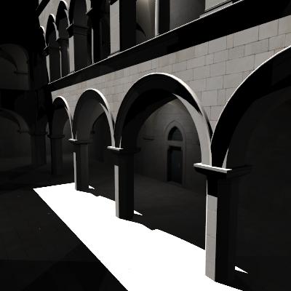
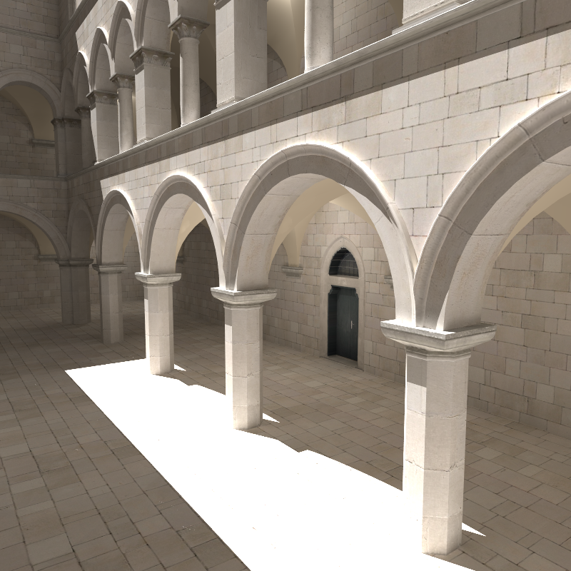
Goal: Global illumination (GI)
Direct illumination
Global =
direct +
indirect
2

Slide 3
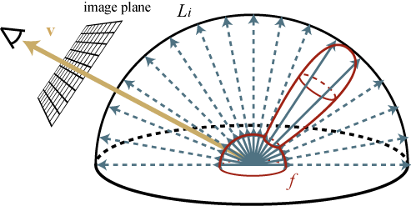
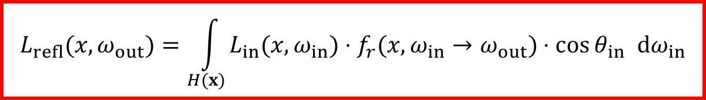
Review: Reflection equation
$$L_{refl}(x, ω_{out})=\int_{H(x)}{L_{in}(x, ω_{in})⋅f_{r}({x,ω}_{in}→ω_{out})⋅\cos{θ_{in}} dω_{in}}$$

Slide 4
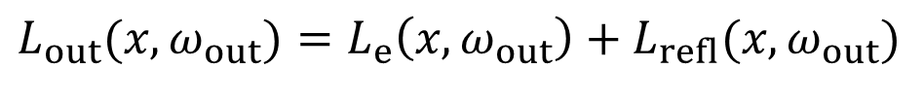
Review: Reflection equation
If the shading point x itself is on an emitting surface
(i.e. if x is on a light source):
Emitted radiance
$$L_{out}(x,ω_{out})=L_{e}\left(x,ω_{out}\right)+L_{refl}(x,ω_{out})$$
Reflected radiance
(previous slide)
Total outgoing radiance

Slide 5


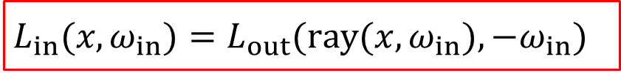



From local reflection to global light transport
Where does the incoming radiance L_{in}(x, ω_{in}) come from, really?
  From other places in the scene!
$$L_{in}(x,ω_{in})=L_{out}(ray(x,ω_{in}),−ω_{in})$$
Ray casting function
$$L_{out}(ray(x,ω_{in}),−ω_{in})$$
$$ray(x,ω_{in})$$
$$=$$
$$L_{in}(x,ω_{in})$$
$$x$$

Slide 6
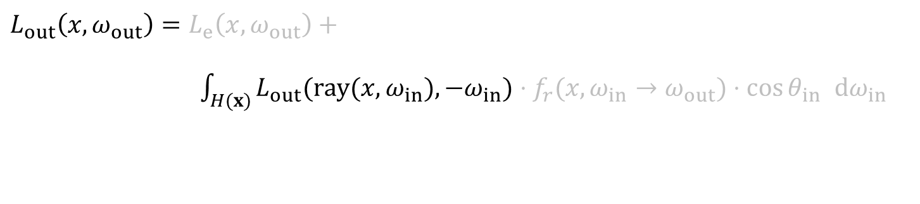
From local reflection to global light transport
Plug for L_{in} into the reflection equation
Incoming radiance L_{in} drops out
Outgoing radiance L_{out} at x is described in terms of L_{out} at other points in the scene
$$L_{out}\left(x, ω_{out}\right)=L_{e}\left(x, ω_{out}\right)+$$
$\int_{H(x)}{L_{out}(ray(x,ω_{in}),−ω_{in})⋅f_{r}({x,ω}_{in}→ω_{out})⋅\cos{θ_{in}} dω_{in}}$

Slide 7
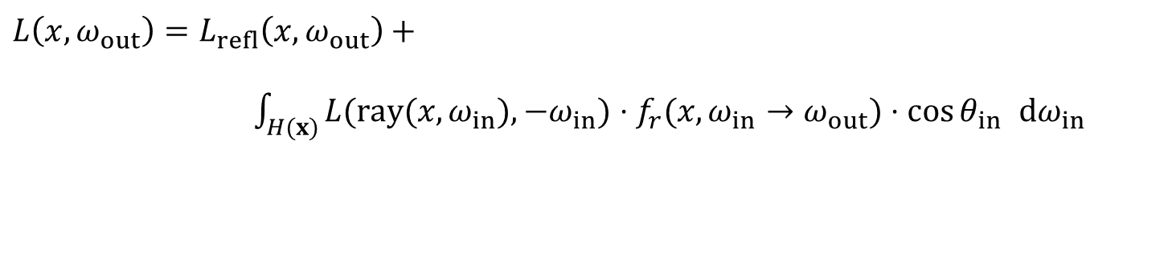
Rendering equation
Removed the subscript “out” from the outgoing radiance for brevity
The RE describes the steady state = energy balance in the scene
Rendering = calculate L(x, ω_{out}) for all points visible through pixels, such that it fulfils the rendering equation
$$L\left(x, ω_{out}\right)=L_{refl}\left(x, ω_{out}\right)+$$
$\int_{H(x)}{L(ray(x,ω_{in}),−ω_{in})⋅f_{r}({x,ω}_{in}→ω_{out})⋅\cos{θ_{in}} dω_{in}}$

Slide 8
Reflection equation vs.
Rendering equation
Similar form – different meaning
Reflection equation
  Describes local light reflection at a single point
  Integral that can be used to calculate the outgoing radiance if we know the incoming radiance
Rendering equation
  Condition on the global distribution of light in scene
  Integral equation – unknown quantity L on both sides

Slide 9
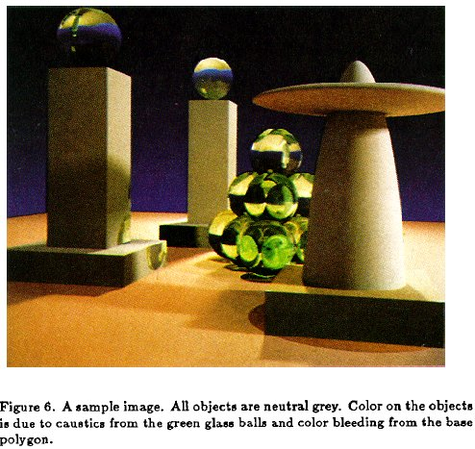
Rendering Equation – Kajiya 1986

Slide 10
Path tracing sketch

Slide 11

Recursive unwinding of the RE
To calculate L(x, ω_{out}), we need to calculate
L(ray(x, ω_{in}), − ω_{in}) for all directions ω_{in} around x.
At each intersected point, we need to do the same recursively.

Slide 12
Path tracing, v. 0.1
estimateLin (x, ω): // radiance incident at x from direction ω
y = findNearestIntersection(x, ω)
if (no intersection)
return backgroud.getLe (y, –ω) // emitted radiance from envmap
else
return getLe (y, –ω) + // emitted radiance (if y is on a light)
estimateLrefl (y, –ω)// reflected radiance
estimateLrefl(x, ω_{out}):
[ω_{in} , pdf] = genRandomDir(x, ω_{out}); // e.g. BRDF imp. sampling
return estimateLin(x, ω_{in}) * brdf(x, ω_{in}, ω_{out}) * dot(n_{x}, ω_{in}) / pdf

Slide 13
Let’s now argue more rigorously why the recursive path tracing actually solves the rendering equation…

Slide 14
The operator form of the RE

Slide 15
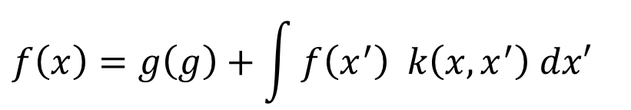
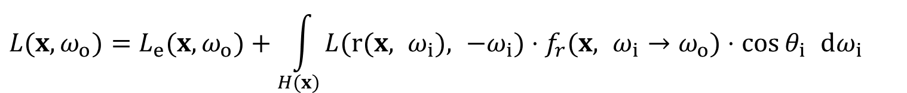
RE is a Fredhom integral equation of the 2nd kind
General form the Fredholm integral equation of the 2nd kind
Rendering equation:
$$f\left(x\right)=g\left(g\right)+\int{f\left(x^{′}\right) k\left(x,x^{′}\right) dx′}$$
unknown
function
known
functions
equation
“kernel”
$$L(x,ω_{o})=L_{e}(x,ω_{o})+\int_{H(x)}{L(r(x, ω_{i}), −ω_{i})⋅f_{r}(x, ω_{i}→ω_{o})⋅\cos{θ_{i}} dω_{i}}$$

Slide 16


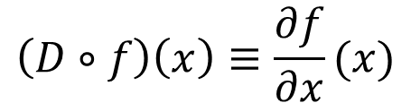
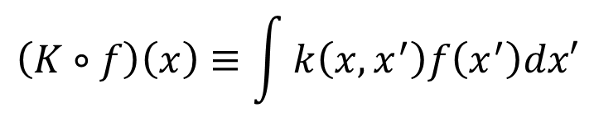
Linear operators
Linear operators act on functions
  (as matrices act on vectors)
The operator is linear if the “acting” is a linear operation
Examples of linear operators
$$h\left(x\right)=(T∘f)(x)$$
$$L∘\left(af+bg\right)=a\left(L∘f\right)+b(L∘g)$$
$$\left(D∘f\right)\left(x\right)≡\frac{∂f}{∂x}(x)$$
$$\left(K∘f\right)\left(x\right)≡\int{k\left(x,x^{′}\right)f\left(x^{′}\right)dx′}$$

Slide 17
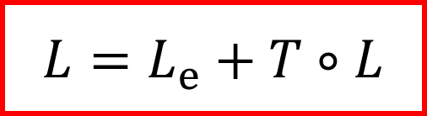
Transport operator
$$(T∘L)(x, ω_{out})≡\int_{H(x)}{L(x, ω_{in})⋅f_{r}(x, ω_{in}→ω_{out})⋅\cos{θ_{in}} dω_{in}}$$
Rendering equation
$$L=L_{e}+T∘L$$

Slide 18

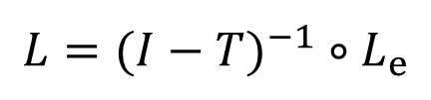

Solution of the RE in the operator form
Rendering equation
Formal solution
  unusable in practice – the inverse cannot be explicitly calculated
$$L=L_{e}+T∘L$$
$$(I−T)∘L=L_{e}$$
$$L=(I−T)^{−1}∘L_{e}$$

Slide 19
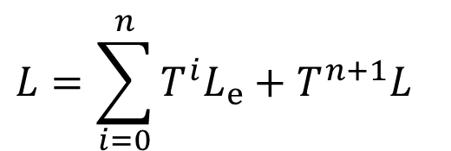

Expansion of the rendering equation
Recursive substitution L
n-fold repetition yields the Neumann series
$$L=L_{e}+TL \\ =L_{e}+T\left(L_{e}+TL\right) \\ =L_{e}+TL_{e}+T^{2}L$$
$$L=\sum_{i=0}^{n}{T^{i}L_{e}}+T^{n+1}L$$

Slide 20
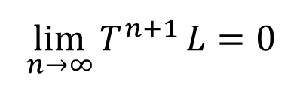
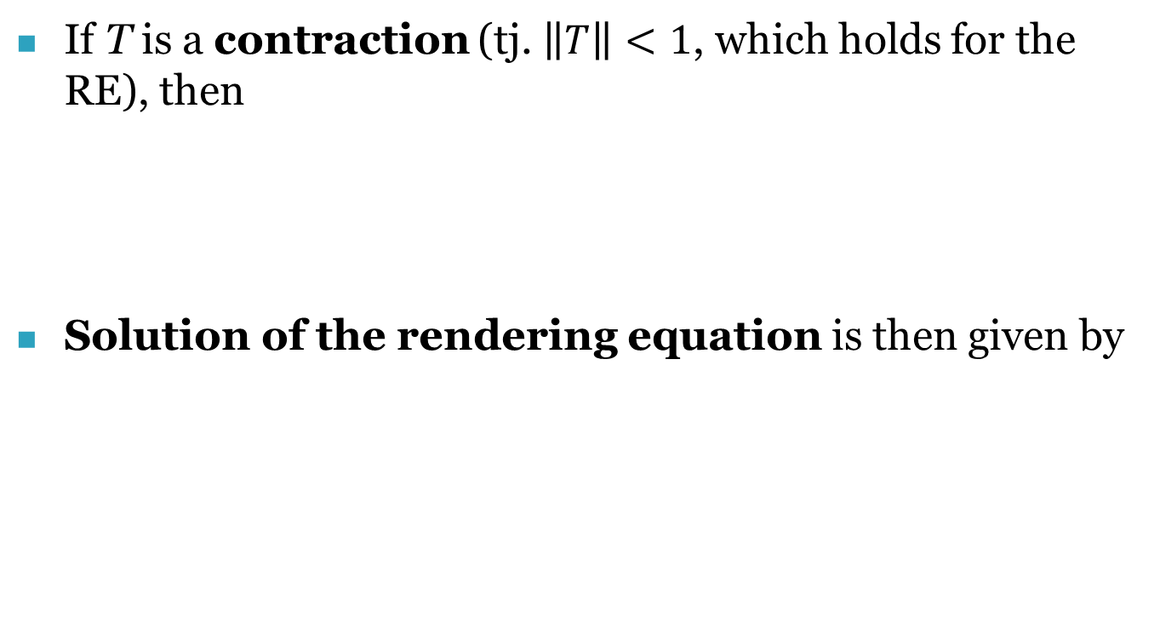

Expansion of the rendering equation
If T is a contraction (tj. $\left\|T\right\|<1$, which holds for the RE), then
Solution of the rendering equation is then given by
$$\lim_{n→∞}{T^{n+1}}L=0$$
$$L=\sum_{i=0}^{∞}{T^{i}L_{e}}$$

Slide 21

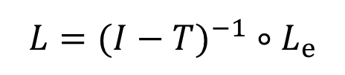
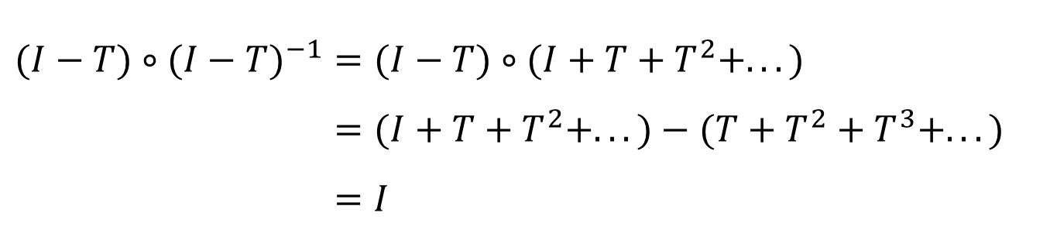
A different derivation of the Neumann series
Formal solution of the rendering equation
Proposition
Proof
$$L=(I−T)^{−1}∘L_{e}$$
$$(I−T)^{−1}=I+T+T^{2}+...$$
$$(I−T)∘(I−T)^{−1}=(I−T)∘(I+T+T^{2}+...) \\ =(I+T+T^{2}+...)−(T+T^{2}+T^{3}+...) \\ =I$$

Slide 22
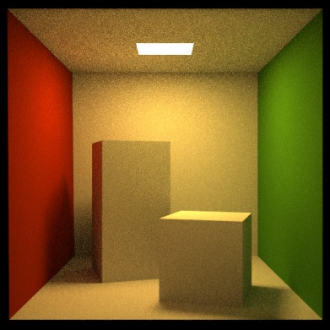
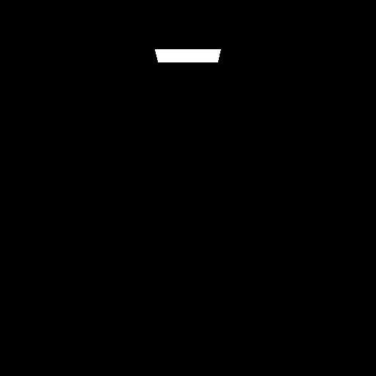
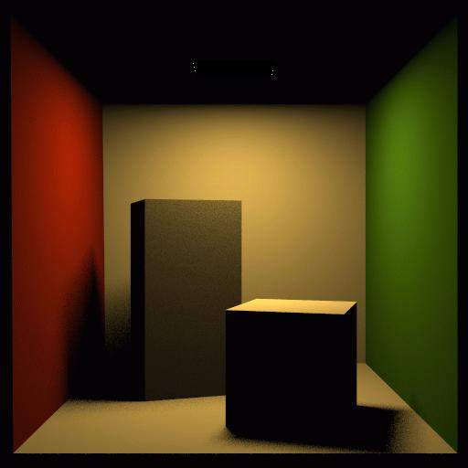
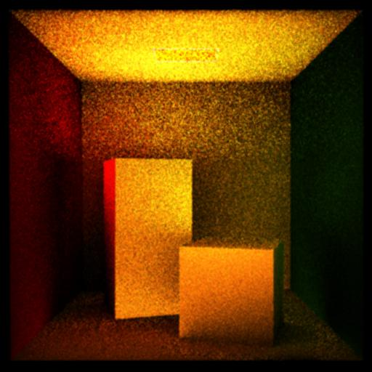
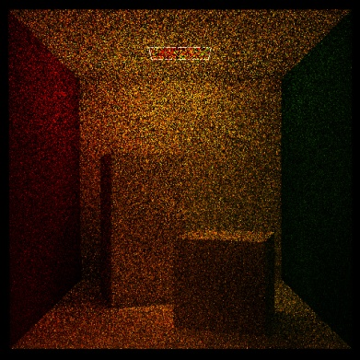
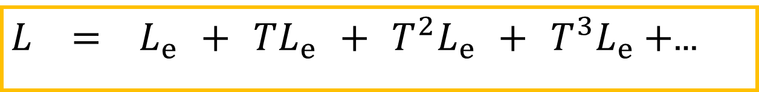
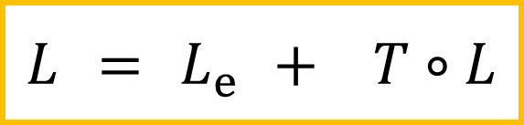
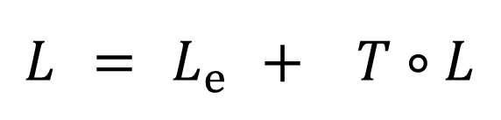
Rendering equation
Solution: Neumann series
$$L = L_{e} + T∘L$$
$$L = L_{e} + T∘L$$
$L = L_{e} + TL_{e} + T^{2}L_{e} + T^{3}L_{e}+$…

Slide 23
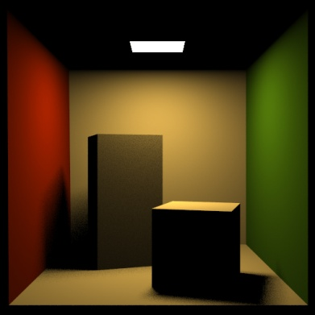
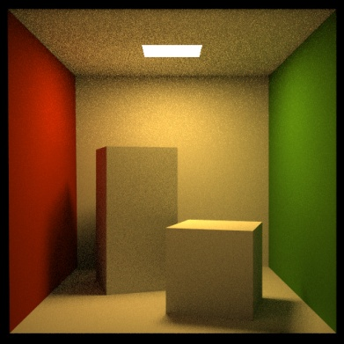
Progressive approximation

Slide 24
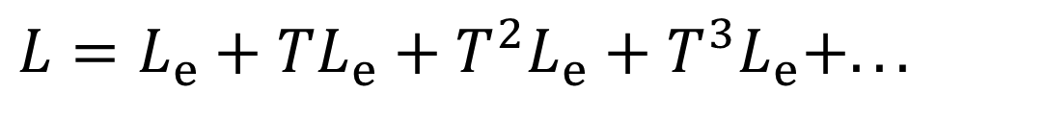
Progressive approximation
Each application of T corresponds to one step of reflection & light propagation
$$L=L_{e}+TL_{e}+T^{2}L_{e}+T^{3}L_{e}+...$$
emission
one-bounce
indirect illumination
direct
illumination
two-bounce
indirect illumination
OpenGL shading

Slide 25
Contractivity of T
Holds for all physically correct models
  Follows from the conservation of energy
It means that repetitive application of the operator lower the remaining light energy (makes sense, since reflection/refraction cannot create energy)
Scenes with white or highly specular surfaces
  reflectivity close to 1
  to achieve convergence, we need to simulate more bounces of light

Slide 26
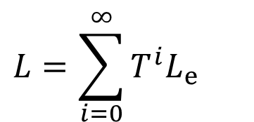

Alright, so what have we achieved?
Rendering
equation
Solution through the
Neumann series
We have replaced an integral equation by a sum of simple integrals
Great, we know how to calculate integrals numerically (the Monte Carlo method), which means that we know how to solve the RE, and that means that we can render images, yay!
Recursive application to T corresponds to the recursive ray tracing from the camera
$$L=\sum_{i=0}^{∞}{T^{i}L_{e}}$$
$$L=L_{e}+T∘L$$

Slide 27


Paths vs. recursion: Same thing, depends on how we look at it
Paths in a high-dimensional path space
Recursive solution of a series of nested (hemi)spherical integrals:
$$L=L_{e}+TL_{e}+T^{2}L_{e}+T^{3}L_{e}+...$$
$$L=L_{e}+T(L_{e}+T(L_{e}+T(L_{e}+...$$

Slide 28
Recursive unwinding of the RE
To calculate L(x, ω_{out}), we need to calculate
L(ray(x, ω_{in}), − ω_{in}) for all directions ω_{in} around x.
At each intersected point, we need to do the same recursively.
We’ve seen this already, right?
But unlike at the beginning of
the lecture, by now we know this
actually solves the RE.

Slide 29
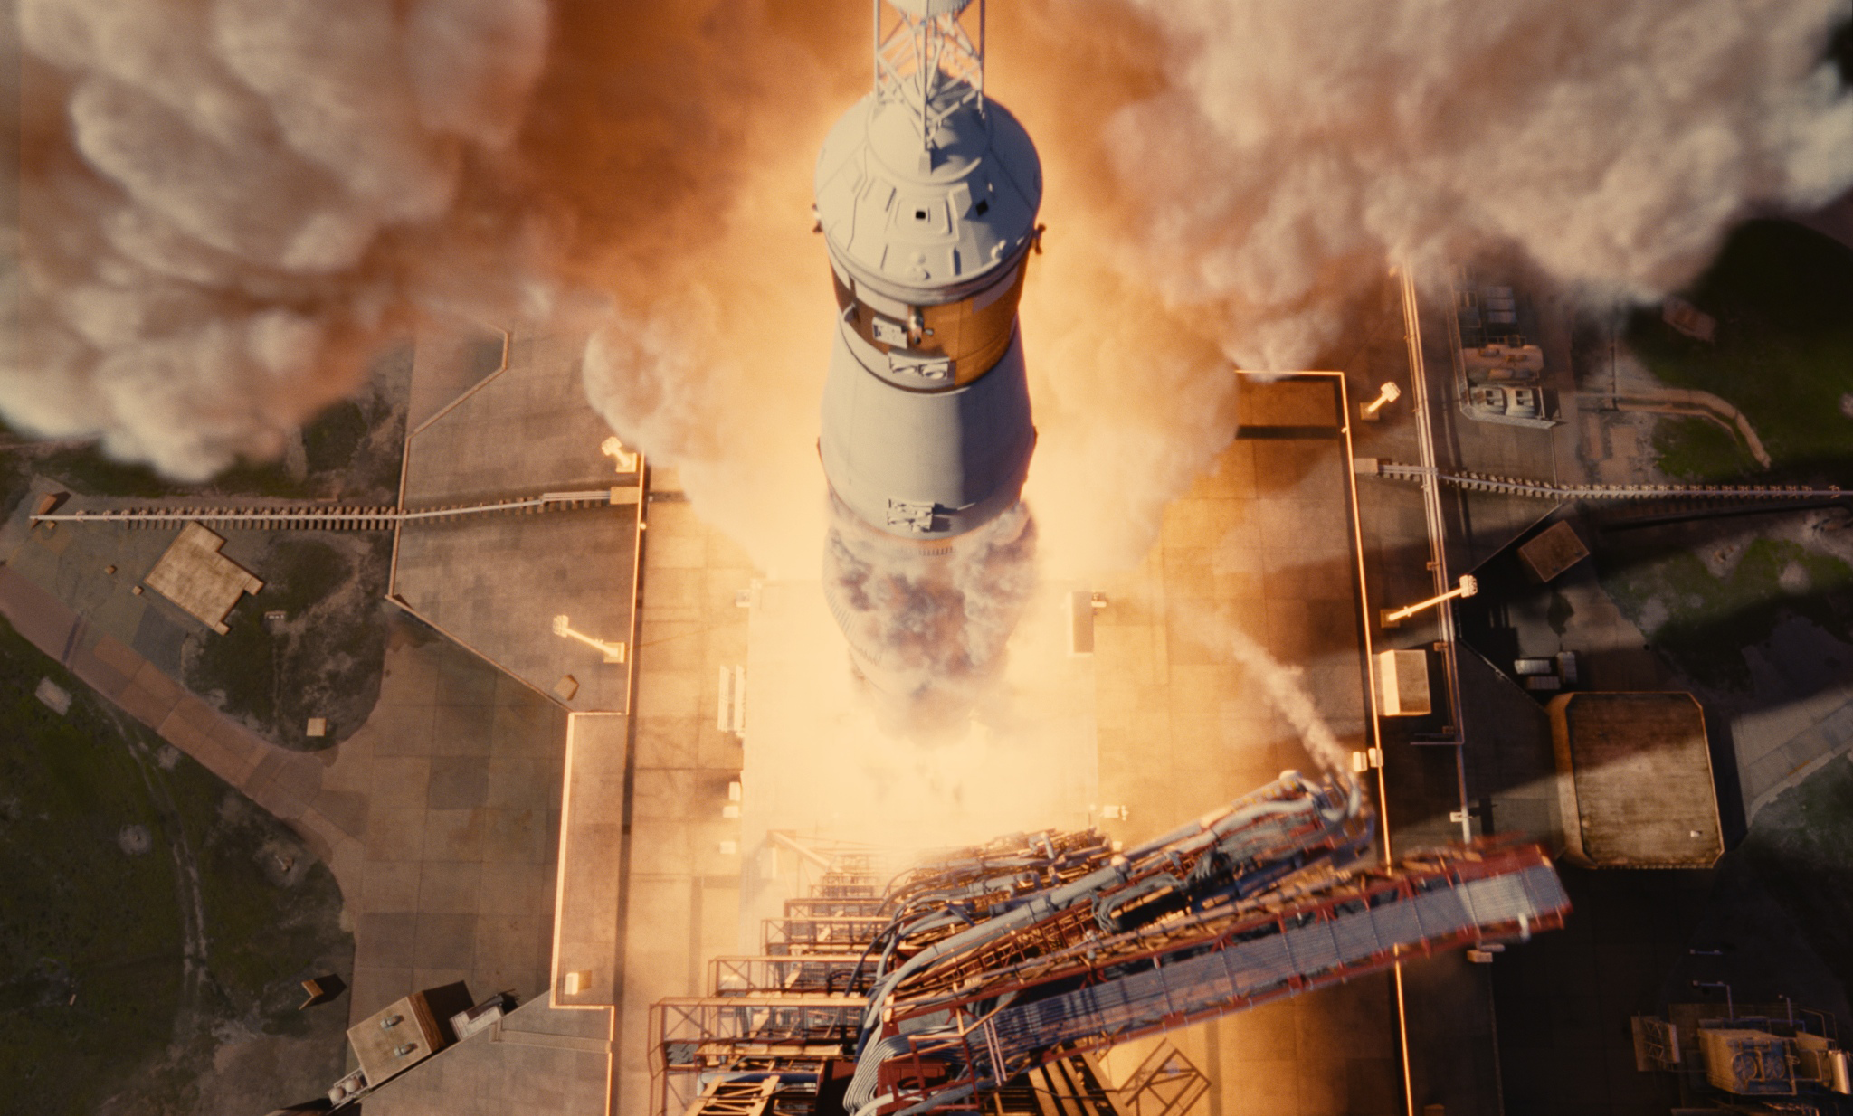
Path tracing, v. 2012, Arnold Renderer
© 2012 Columbia Pictures Industries, Inc. All Rights Reserved.

Slide 30


Notes:
Ale samozrejme nechceme nase know-how pouze vyvazet ven a proto jsme zalozili domaci firmu, ktera vyviji renderovaci software jmenem Corona Renderer.
Hlavnim vyvojarem a tahounem tohoto projektu je nas byvaly doktorand Ondra Karlik na teto fotce.

Slide 31
Angular and Area form of the rendering equation

Slide 32
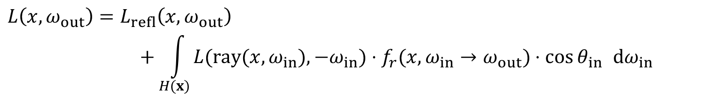
Angular integral form of the RE
Integral over the hemisphere in incoming directions
$$L\left(x, ω_{out}\right)=L_{refl}\left(x, ω_{out}\right)$$
$$+\int_{H(x)}{L(ray(x,ω_{in}),−ω_{in})⋅f_{r}({x,ω}_{in}→ω_{out})⋅\cos{θ_{in}} dω_{in}}$$

Slide 33
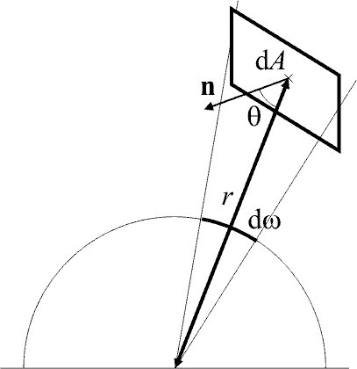
Going from angular to area form
Change-of-variables applied to the angular form

Slide 34
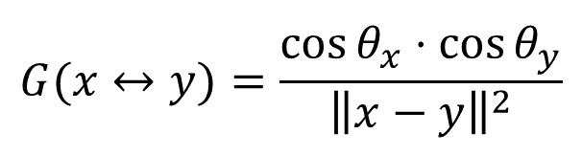
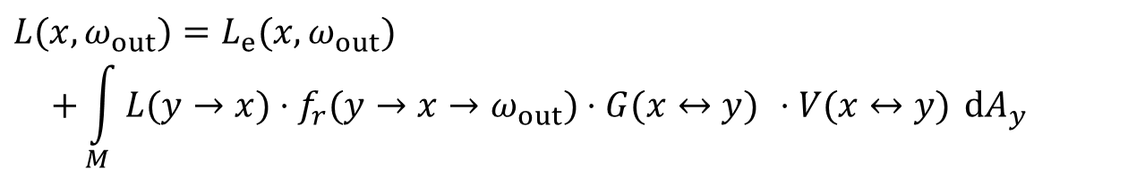
Area integral form of the RE
Area form
  Integral over the scene surface
$$L(x,ω_{out})=L_{e}(x,ω_{out}) \\ +\int_{M}{L(y→x)⋅f_{r}(y→x→ω_{out})⋅G(x↔y) ⋅V(x↔y) dA_{y}}$$
scene surface
visibility
1 … y visible from x
0 … otherwise
geometry term
$$G(x↔y)=\frac{\cos{θ_{x}}⋅\cos{θ_{y}}}{{\left\|x−y\right\|}^{2}}$$

Slide 35
Angular integral form
Sum up radiance contributions from all directions
For each direction, find the nearest surface by ray tracing
Implementation in stochastic path tracing:
  For a given x, generate random direction(s), for each find the nearest intersection, return the outgoing radiance at that intersection and multiply it with the cosine-weighted BRDF.

Slide 36
Area integral form
Sum up contributions from all other points on the scene surface
  Contribution added only if visible
Implementation in stochastic path tracing:
  Generate randomly point y on scene geometry (e.g. on a light source). Test visibility between x and y. If mutually visible, add the outgoing radiance at y modulated by the geometry factor.
Typical use: direct illumination calculation for area light sources

Slide 37
Most rendering algorithms = (approximate) solution of the RE
Local illumination (OpenGL)
  Only point sources, integral becomes a sum
  Does not calculate equilibrium radiance, is not really a solution of the RE
Finite element methods (radiosity) [Goral, ’84]
  Discretize scene surface (finite elements)
  Disregard directionality of reflections: everything is assumed to be diffuse
  Cannot reproduce glossy reflections

Slide 38
Most rendering algorithms = (approximate) solution of the RE
Ray tracing [Whitted, ’80]
  Direct illumination on diffuse and glossy surfaces due to point sources
  Indirect illumination only on ideal mirror reflection / refractions
  Cannot calculate indirect illumination on diffuse and glossy scenes, soft shadows etc. …
Distributed ray tracing [Cook, ’84]
  Estimate the local reflection using the MC method
  Can calculate soft shadows, glossy reflections, camera defocus blur, etc.

Slide 39
Most rendering algorithms = (approximate) solution of the RE
Path tracing [Kajiya, ’86]
  True solution of the RE via the Monte Carlo method
  Tracing of random paths (random walks) from the camera
  Can calculate indirect illumination of higher order

Slide 40
From the rendering equation to finite element radiosity
(Optional material)

Slide 41
From the RE to radiosity
Start from the area integral form of the RE
The Radiosity method– assumptions
  Only diffuse surfaces (BRDF constant in ω_{in} and ω_{out})
  Radiosity (i.e. radiant exitance) is spatially constant (flat) over the individual elements

Slide 42
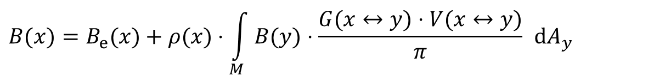
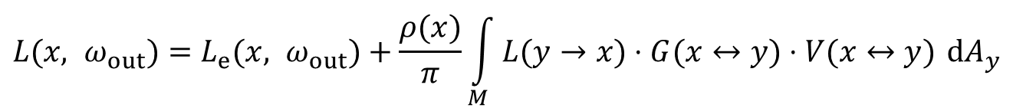

From the RE to radiosity
Diffuse surfaces only
  The BRDF is constant in ω_{in} and ω_{out}
  Outgoing radiance is independent of ω_{out} . It is equal to radiosity B divided by π
$$L(x, ω_{out})=L_{e}(x, ω_{out})+\frac{ρ(x)}{π}\int_{M}{L(y→x)⋅G(x↔y)⋅V(x↔y) dA_{y}}$$
$$B(x)=B_{e}(x)+ρ(x)⋅\int_{M}{B(y)⋅\frac{G(x↔y)⋅V(x↔y)}{π} dA_{y}}$$
$$G′(x↔y)$$

Slide 43
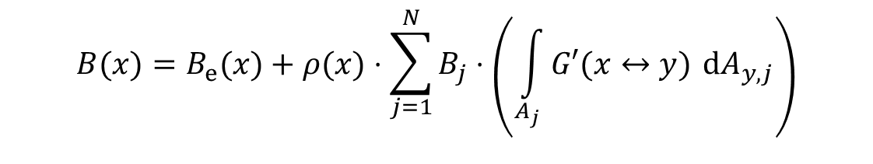
From the RE to radiosity
Spatially constant (flat) radiosity B of the contributing surface elements
$$B(x)=B_{e}(x)+ρ(x)⋅\sum_{j=1}^{N}{B_{j}⋅\left(\int_{A_{j}}{G′(x↔y) dA_{y,j}}\right)}$$
Radiosity of the j-th element
Geometry factor between
surface element j and point x

Slide 44
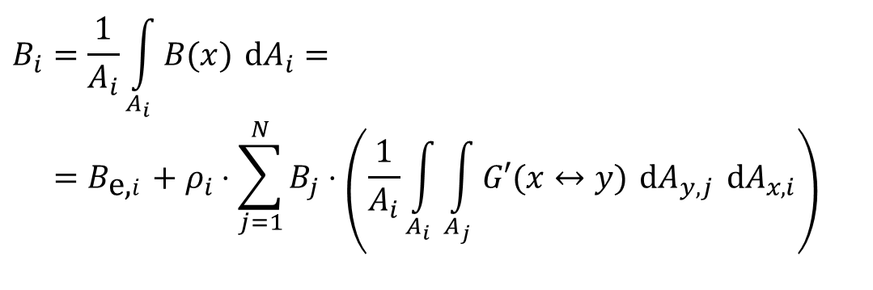

From the RE to radiosity
Spatially constant (flat) radiosity of the receiving surface element i:
  Average radiosity over the element
$$B_{i}=\frac{1}{A_{i}}\int_{A_{i}}{B(x) dA_{i}}= \\ =B_{\text{e}\text{,}i}+ρ_{i}⋅\sum_{j=1}^{N}{B_{j}⋅\left(\frac{1}{A_{i}}\int_{A_{i}}{\int_{A_{j}}{G′(x↔y) dA_{y,j} dA_{x,i}}}\right)}$$
$$F_{ij}$$
… form factor

Slide 45
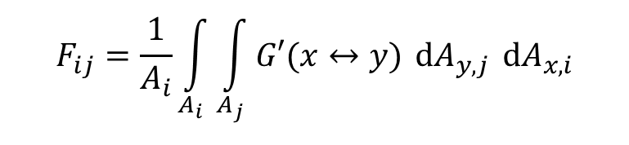
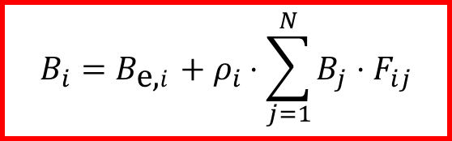
Classic radiosity equation
System of linear equations
Form factors
Conclusion: the radiosity method is nothing but a way to solve the RE under a specific set of assumptions
$$B_{i}=B_{\text{e}\text{,}i}+ρ_{i}⋅\sum_{j=1}^{N}{B_{j}⋅F_{ij}}$$
$$F_{ij}=\frac{1}{A_{i}}\int_{A_{i}}{\int_{A_{j}}{G′(x↔y) dA_{y,j} dA_{x,i}}}$$

Slide 46
Radiosity method
Classical radiosity
  Form facto calculation (Monte Carlo, hemicube, …)
  Solve the linear system (Gathering, Shooting, …)
Stochastic radiosity
  Avoids explicit calculation of form factors
  Metoda Monte Carlo
Radiosity is not practical, not used anymore
  Scene subdivision -> sensitive to the quality of the geometry model (but in reality, models are always broken)
  High memory consumption, complex implementation

